Slide 1
Two Birds Publishing
ebook product update

Slide 2
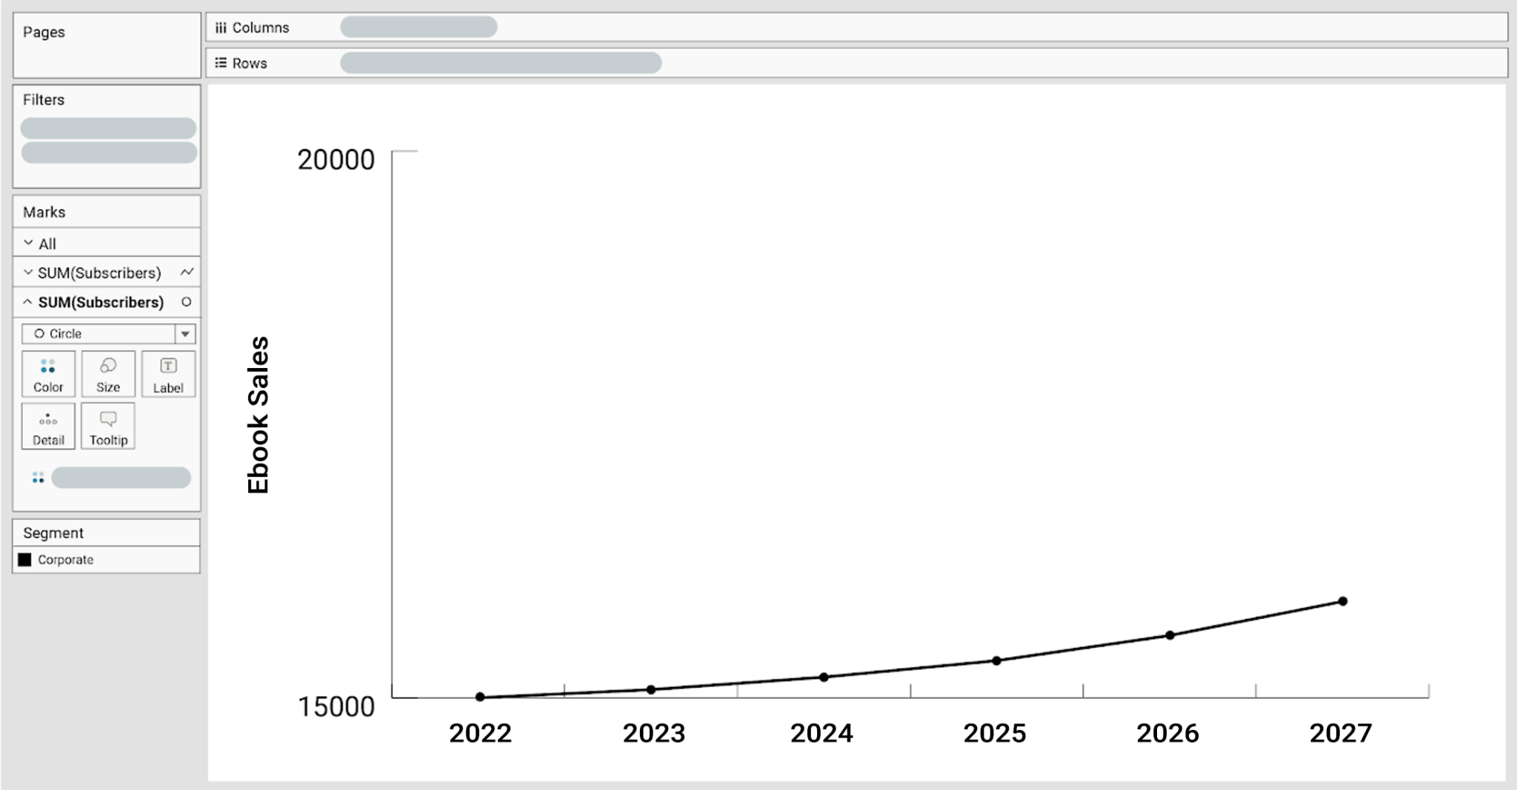
Team Objective
Goal 1: Ebook sales +11% YoY.
Currently +7%

Slide 3




Recent accomplishments
Rewards program
New features
expanded genres
early access to publications
cross-device reading
Business case sales forecasts predict the return on investment to be 15% higher than we expected!
Launch Updates:
Launched Wednesday evening. Thursday morning we discovered bugs
Obstacle: customer service received a high volume of calls expressing users could not sign in to their accounts
Solution: communicated to customers what is going on, informed the relevant department heads the root cause of issue and how to proceed on getting it resolved. The development team’s goal is to resolve this before the weekend.
In the future: Work with cross functional teams to launch with a cushion window in case any technical issues surface. This way, we can resolve them before pushing the final product out to customers.

Slide 4


Short-term Work
In the next 2 months…
Prioritized the Rewards Program launch over UX Update
Rationale: Sales forecasts revealed higher, faster ROI for rewards program. Customer data also showed positive response from current users
UX Update pushed a month out
Impact- increase ebook sales by 5% and improve navigation and usability of the ebook app
Notes:
We ran a sample customer focus group research initiative

Slide 5




Long-term Work
In the next 4 months…
User data security update
Impact - mitigate risk against surge of data breaches affecting our industry
Notes:
We’ll be working with the IT Director and the Director of Data Compliance on this

Slide 6

A Vision for the Future
Vision Statement Process
Reviewed user personas and value proposition canvas
Needed to be timeless verbiage, opening opportunity for further expansion
Needed to communicate our users’ feelings
“Enchanting readers with a world of knowledge they can experience together, anytime, anywhere.”
Notes:
it speaks on the wide variety of genres, the user experience regarding community, and the ease of use across devices. It also can be applied to the company goals 5-10 years in the future. I wanted to use the word “enchant” because it sounds like a word used in a story that transports you to a fictional place. This is powerful because readers transport into another world when reading books and this could remind them of their childhood. I wanted to emphasize “knowledge they can experience together” to enhance the user experience of connecting with other readers. Reading can be a lonely feat, but Two Birds One Stone could differentiate itself by creating a loyal community that uplift and empower one another. The editorial manager will be satisfied because “world of knowledge” communicates the genre expansion. Overall, it specifies “how” TBOS will enchant people. It also opens up opportunities for even more genre expansion, since “world of knowledge” can encompass a vast variety of subject matter.

